Slide 1

Spam Message Classification Using Decision Tree Machine Learning
PROJECT MEMBERS :
JOY SAMUL , ID : 241001001188
JUNAYEED AHMED , ID : 241001001172
AGNIK ROY , ID : 241001001181
SHOURJYA ROY, ID : 241001001179
ARJU DAS, ID : 241001001155
ANKITA SOM , ID : 241001001184

Slide 2
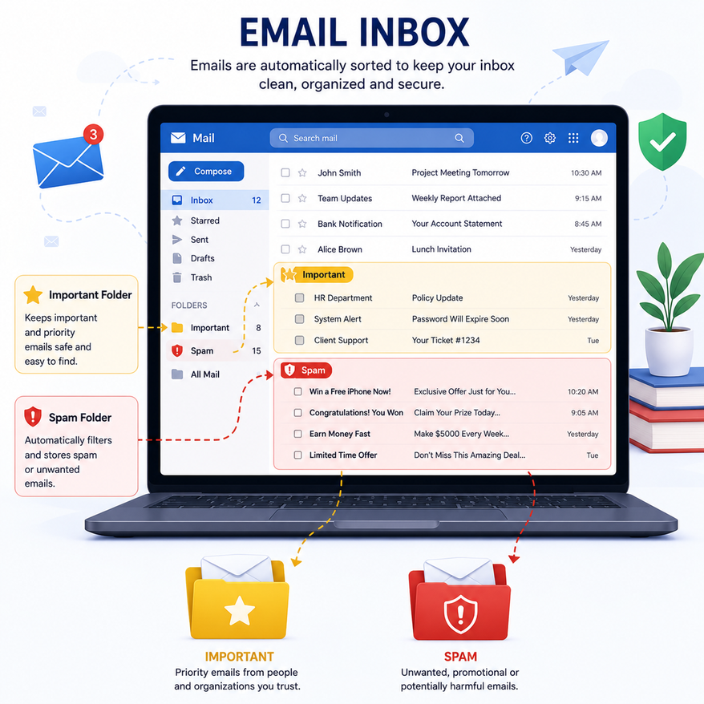
Problem
Statement
Why Spam Detection is Important?
  Billions of spam emails and messages are sent daily.
  Spam causes productivity loss.
  Many spam messages contain scams and phishing attacks.
  Manual filtering is inefficient.
Project Objective
To build an intelligent system that automatically classifies incoming messages as:
  Spam
  Ham (Not Spam)
Visual
  Inbox with Spam Folder and Important Folder.

Slide 3


Introduction to Machine Learning

Slide 4
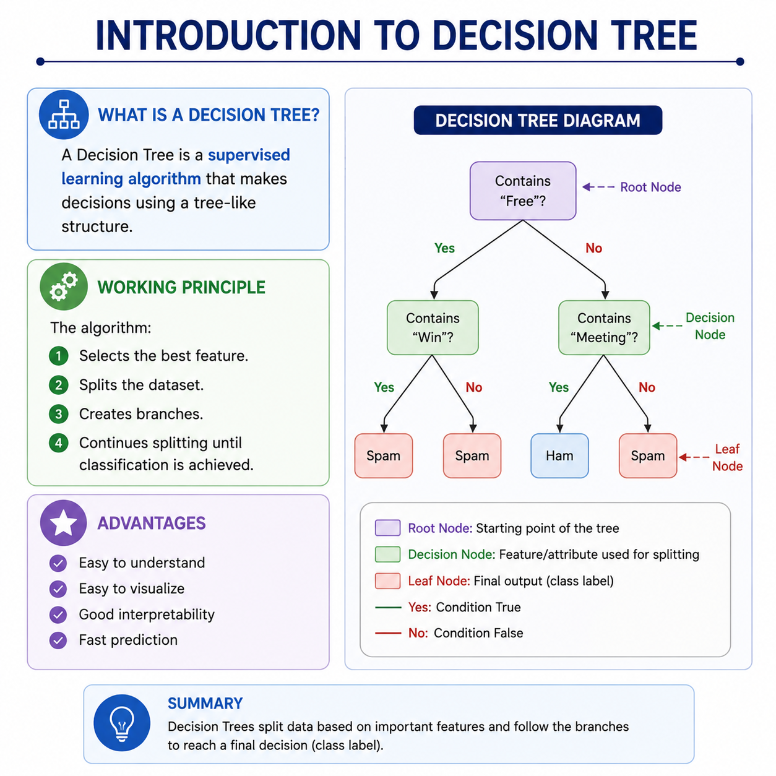
Introducing to Decision Tree
What is a Decision Tree?
A Decision Tree is a supervised learning algorithm that makes decisions using a tree-like structure.
Working Principle
Advantages
The algorithm:
  Selects the best feature.
  Splits the dataset.
  Creates branches.
  Continues splitting until classification is achieved.
  Easy to understand
  Easy to visualize
  Good interpretability
  Fast prediction

Slide 5


Dataset Description
Message | Label
Win a free iPhone now | Spam
Meeting tomorrow at 10 AM | Ham
Claim your reward today | Spam
Project submission deadline | Ham
Dataset Information
  Total Messages: 200
  Spam Messages: 100
  Ham Messages: 100
Dataset format
  CSV File:
  Message Column
  Label Column

Slide 6
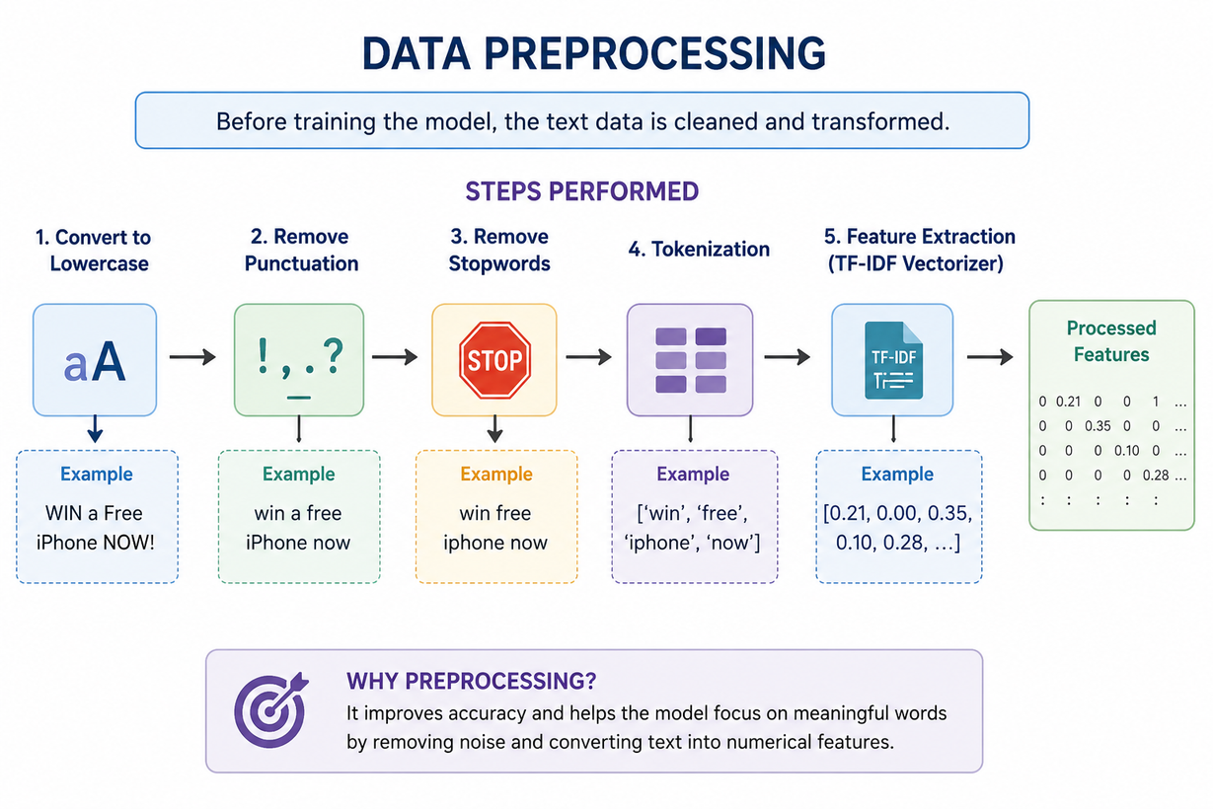

Data Preprocessing
Preprocessing Steps
Before training the model, the text data is cleaned and transformed.
Why Preprocessing?
it improves accuracy and helps the model focus on meaningful words.

Slide 7
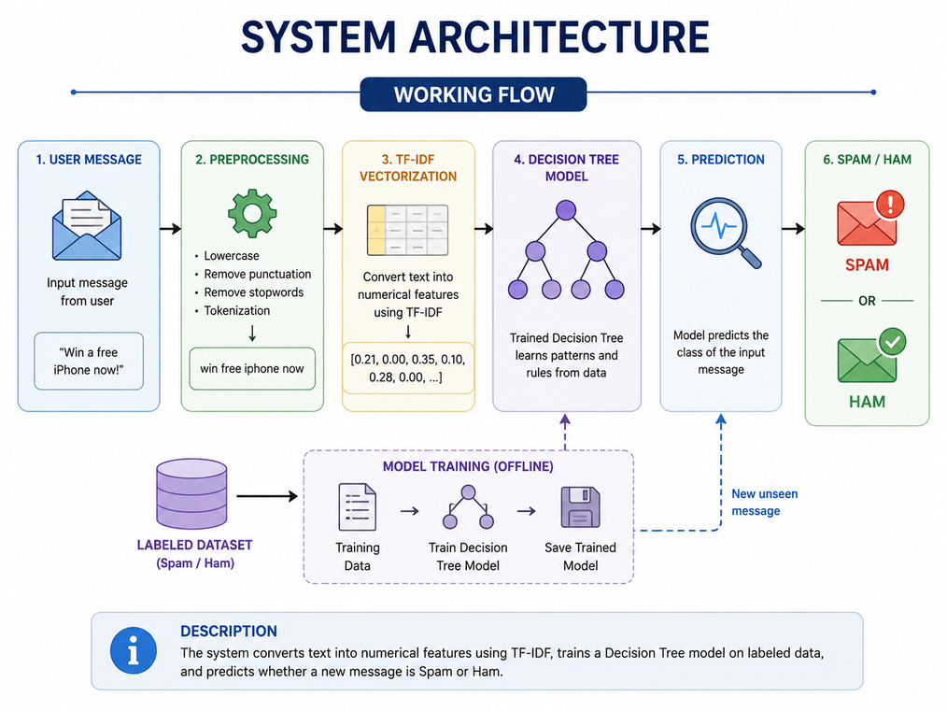

System Architecture
  The system converts text into numerical features, trains a Decision Tree model, and predicts the class of new messages

Slide 8
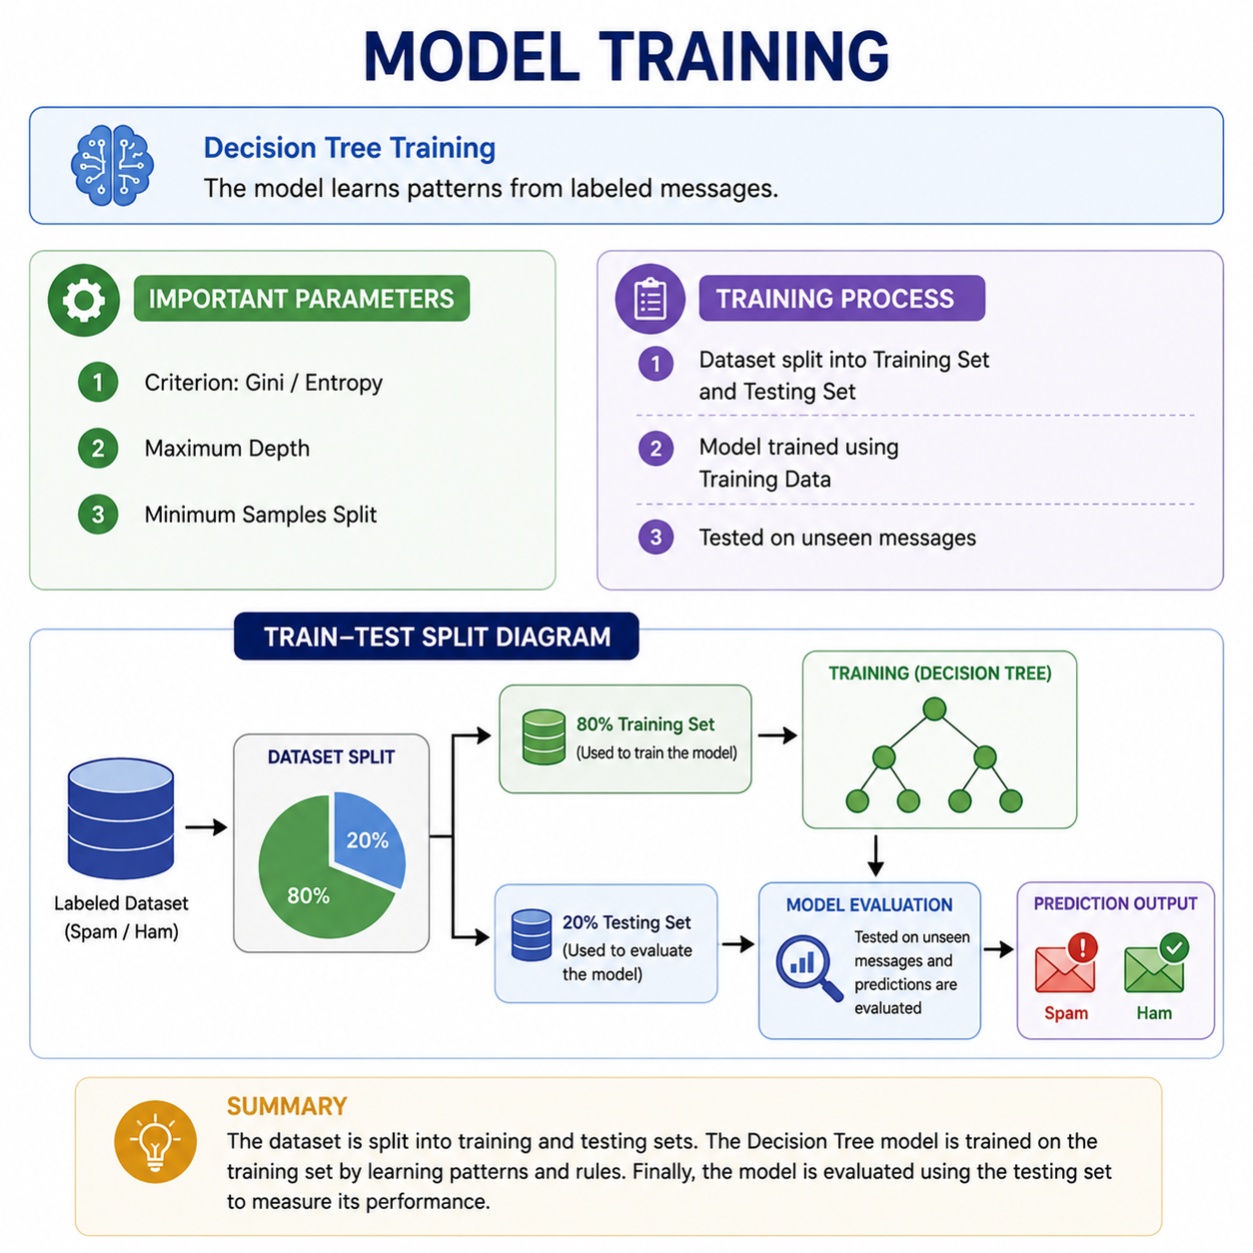

Model Training
Decision Tree Training
The model learns patterns from labeled messages.
Important Parameters
  Criterion: Gini / Entropy
  Maximum Depth
  Minimum Samples Split
Training Process
  Dataset split into Training Set and Testing Set
  Model trained using Training Data
  Tested on unseen messages

Slide 9
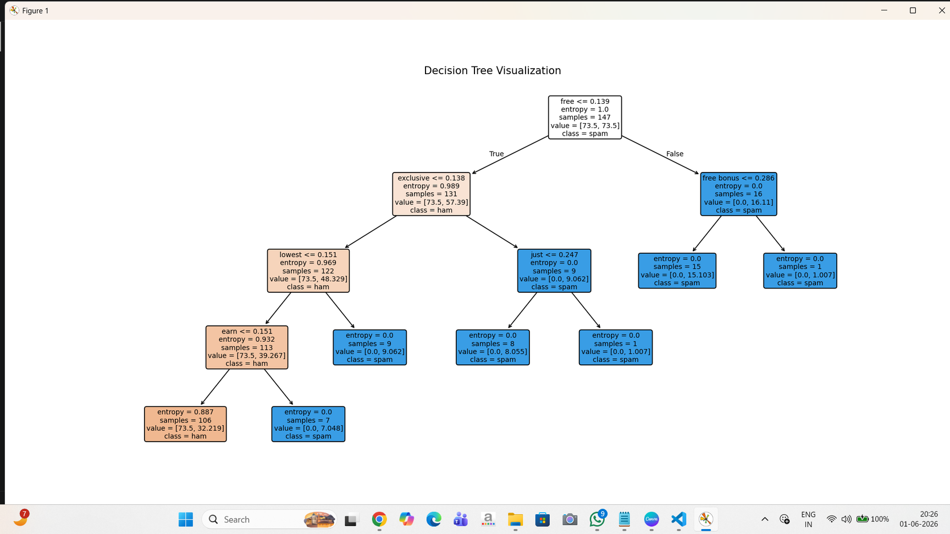

Decision Tree Visualization
Decision Tree Structure
The tree uses important words to split the data.
Example Rules
If message contains:
  "Free" → Spam
  "Winner" → Spam
  "Meeting" → Ham
  "Project" → Ham

Slide 10
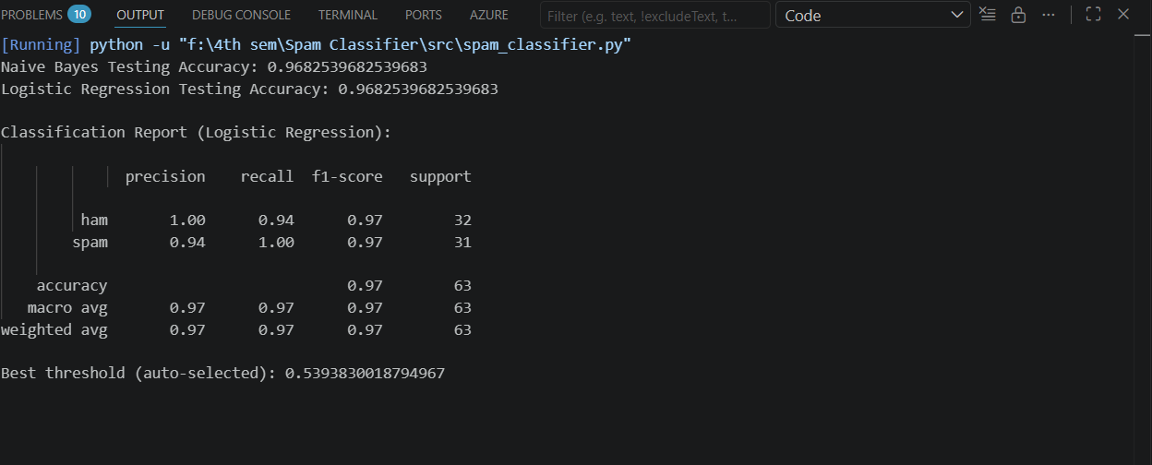
Evaluation Metrics
Performance Metrics
Accuracy
Precision
Recall
F1 Score
Why These Metrics?
They measure how effectively the model identifies spam while minimizing false alarms.

Slide 11
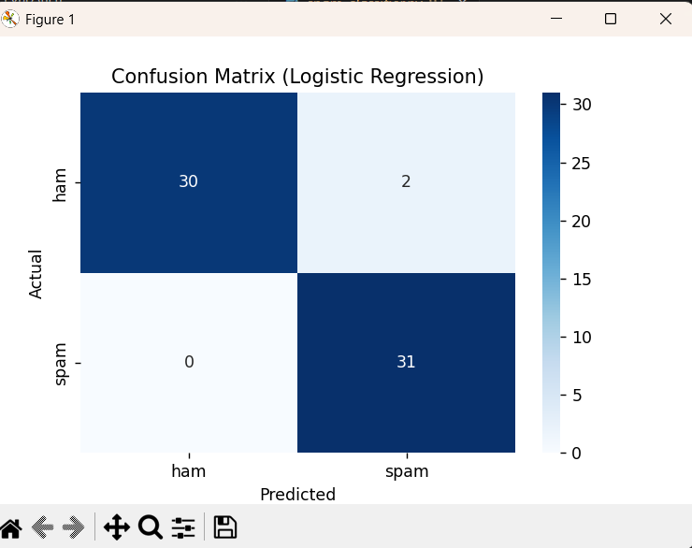
Confusion Metrics
What is a Confusion Matrix?
A confusion matrix shows the number of correct and incorrect predictions.
Components
  True Positive
  True Negative
  False Positive
  False Negative

Slide 12
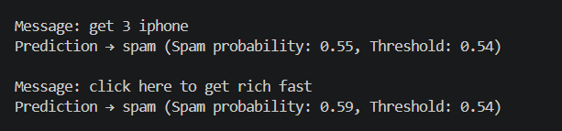
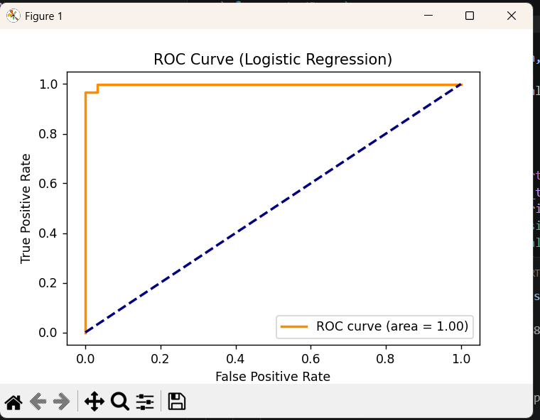

Results and Predictions

Slide 13


Applications
Real-World Applications
  Gmail Spam Filter
  Outlook Email Protection
  SMS Spam Detection
  Social Media Message Filtering
  Cybersecurity Systems

Slide 14
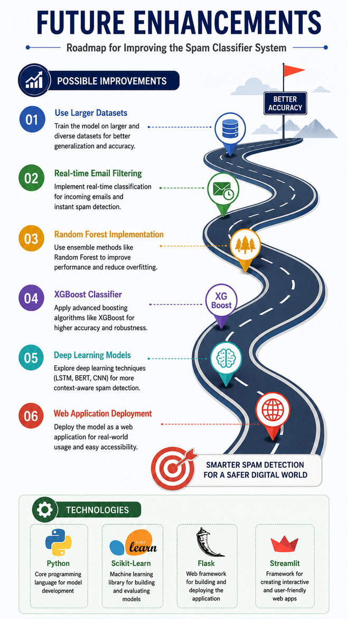

Future Enhancements
Possible Improvements
  Use larger datasets
  Real-time email filtering
  Random Forest implementation
  XGBoost classifier
  Deep Learning models
  Web Application Deployment
Technologies
  Python
  Scikit-Learn
  Flask
  Streamlit

Slide 15

Thank You
Very Much
  Successfully developed a spam classification system using Decision Tree.
  Achieved high classification accuracy.
  Automated spam detection reduces manual effort.
  Decision Tree provides easy interpretation and visualization.
  The project demonstrates the practical application of Machine Learning in cybersecurity and communication systems.

